Slide 1
DIGITAL PORTFOLIO
STUDENT NAME : pranavya.C
REGISTER NO: 212402491
NM ID(username): D9FF64221D58AFB88BD404479A73C7FC
DEPARTMENT: BCA
COLLEGE AND UNIVERSITY: A.M.Jain college and Madras university

Slide 2


DIGITAL PORTFOLIO

Slide 3


AGENDA
1.Problem statement
2.Project Overview
3.End Users
4.Tools and Technologices
5.Portfolio design and Layout
6.Features and Functionality
7.Results and Screenshots
8.Conclusion
9.Github link
.

Slide 4
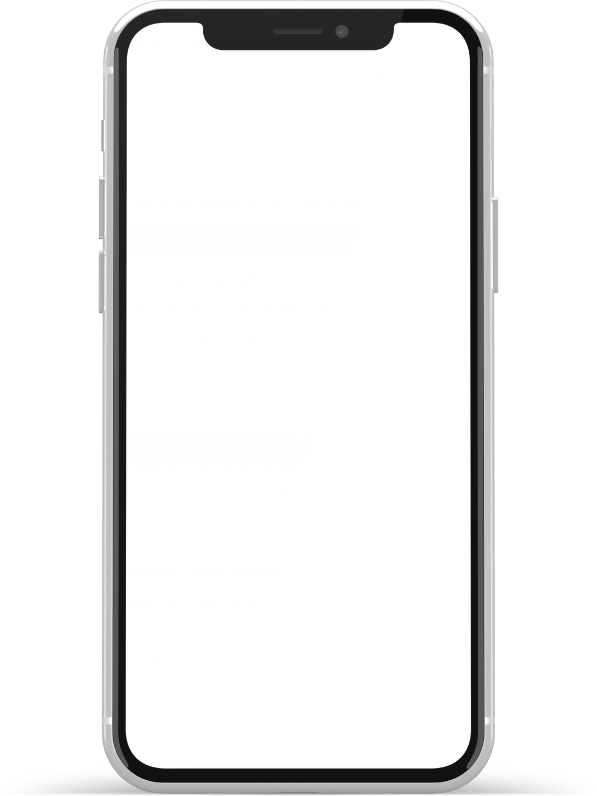

In the digital world, showcasing skills and projects through a traditional resume is not enough. Recruiters and clients need an engaging, professional, and interactive way to evaluate talent. A personal portfolio website solves this problem by creating a strong online presence, highlighting expertise, and providing easy ways to connect.
PROBLEM STATEMENT

Slide 5
project overview
This project is a responsive personal portfolio website for Pranavya.C. It features a modern design, smooth navigation, and interactive elements such as animations and a contact form. The website includes sections like About, Skills, Projects, and Contact to provide a complete overview of professional capabilities.t

Slide 6


who are the end users?
Recruiters & Hiring Managers – to quickly review skills and past work.
Clients – to explore services and potential collaborations.
Peers/Developers – to connect and collaborate on projects.
General Audience – to know more about the developer.

Slide 7
Tools and techniques
Languages: HTML5, CSS3, JavaScript
Icons & UI: Font Awesome
Design Principles: Responsive design, Flexbox, CSS Grid, Transitions & Animations
Hosting Platforms (optional): GitHub Pages, Netlify, Vercel

Slide 8
PORTFOLIO DESIGN AND LAYOUT
Header & Navigation: Sticky navbar with hamburger menu for mobile devices.
Hero Section: Introduction with name, title, and call-to-action button.
About Section: Profile image, bio, and career highlights.
Skills Section: Grid cards showcasing technical skills.
Projects Section: Project cards with images, descriptions, and links.
Contact Section: Contact form + email, phone, and location details.
Footer: Social media links, newsletter subscription, quick links.

Slide 9
FEAUTURES AND FUNCTIONALITY
Responsive design (works on mobile, tablet, desktop).
Smooth scrolling and sticky header.
Sparkle animation effect on buttons.
Hover animations for project cards.
Interactive contact form with alert confirmation.
Newsletter subscription form.
Social media integration (Twitter, Instagram, LinkedIn, GitHub).

Slide 10
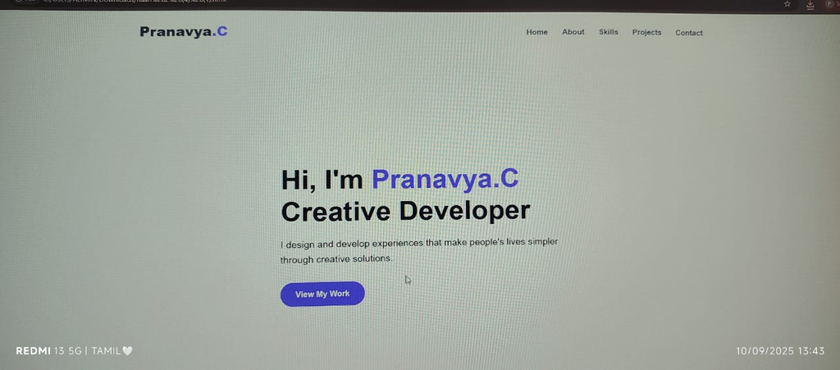
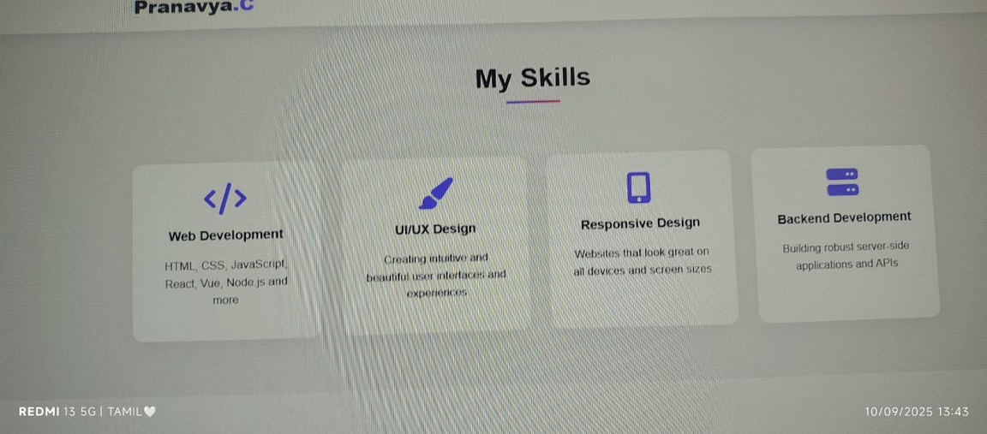
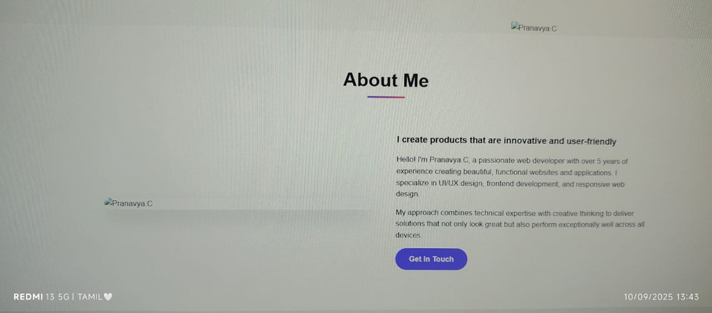
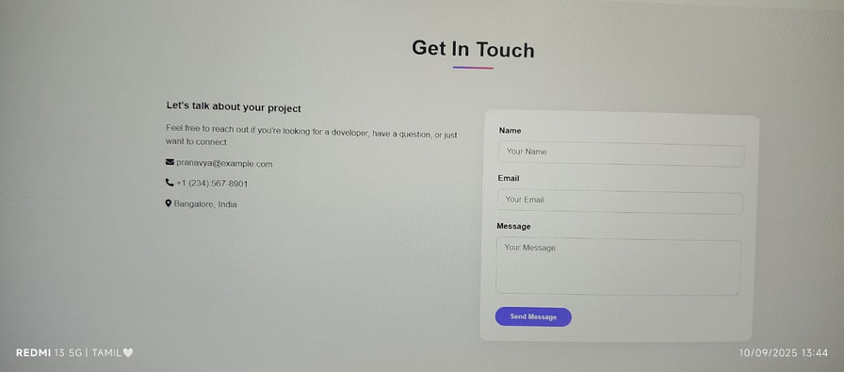
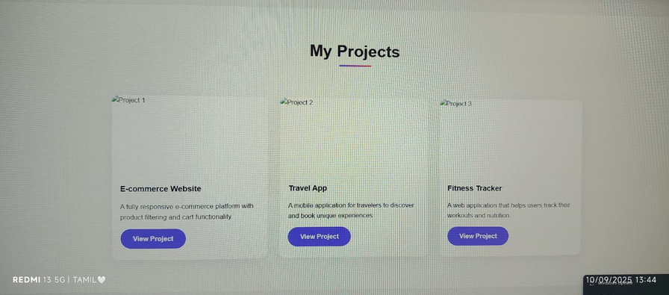
RESULT AND SCREENSHOTS

Slide 11
CONCLUSION
The portfolio website serves as a digital identity for Pranavya.C, effectively showcasing skills, projects, and contact information in an interactive way. It is responsive, user-friendly, and visually attractive. This project not only improves professional opportunities but also demonstrates frontend development and design capabilities.

Slide 12
Github link
Sever Link: https://github.com/24h214-lgtm/TNSDC-FWD-DP1.git
Develoyment Link: https://24h214-lgtm.github.io/TNSDC-FWD-DP1/

Slide 13
Thankyou!!

